Slide 1
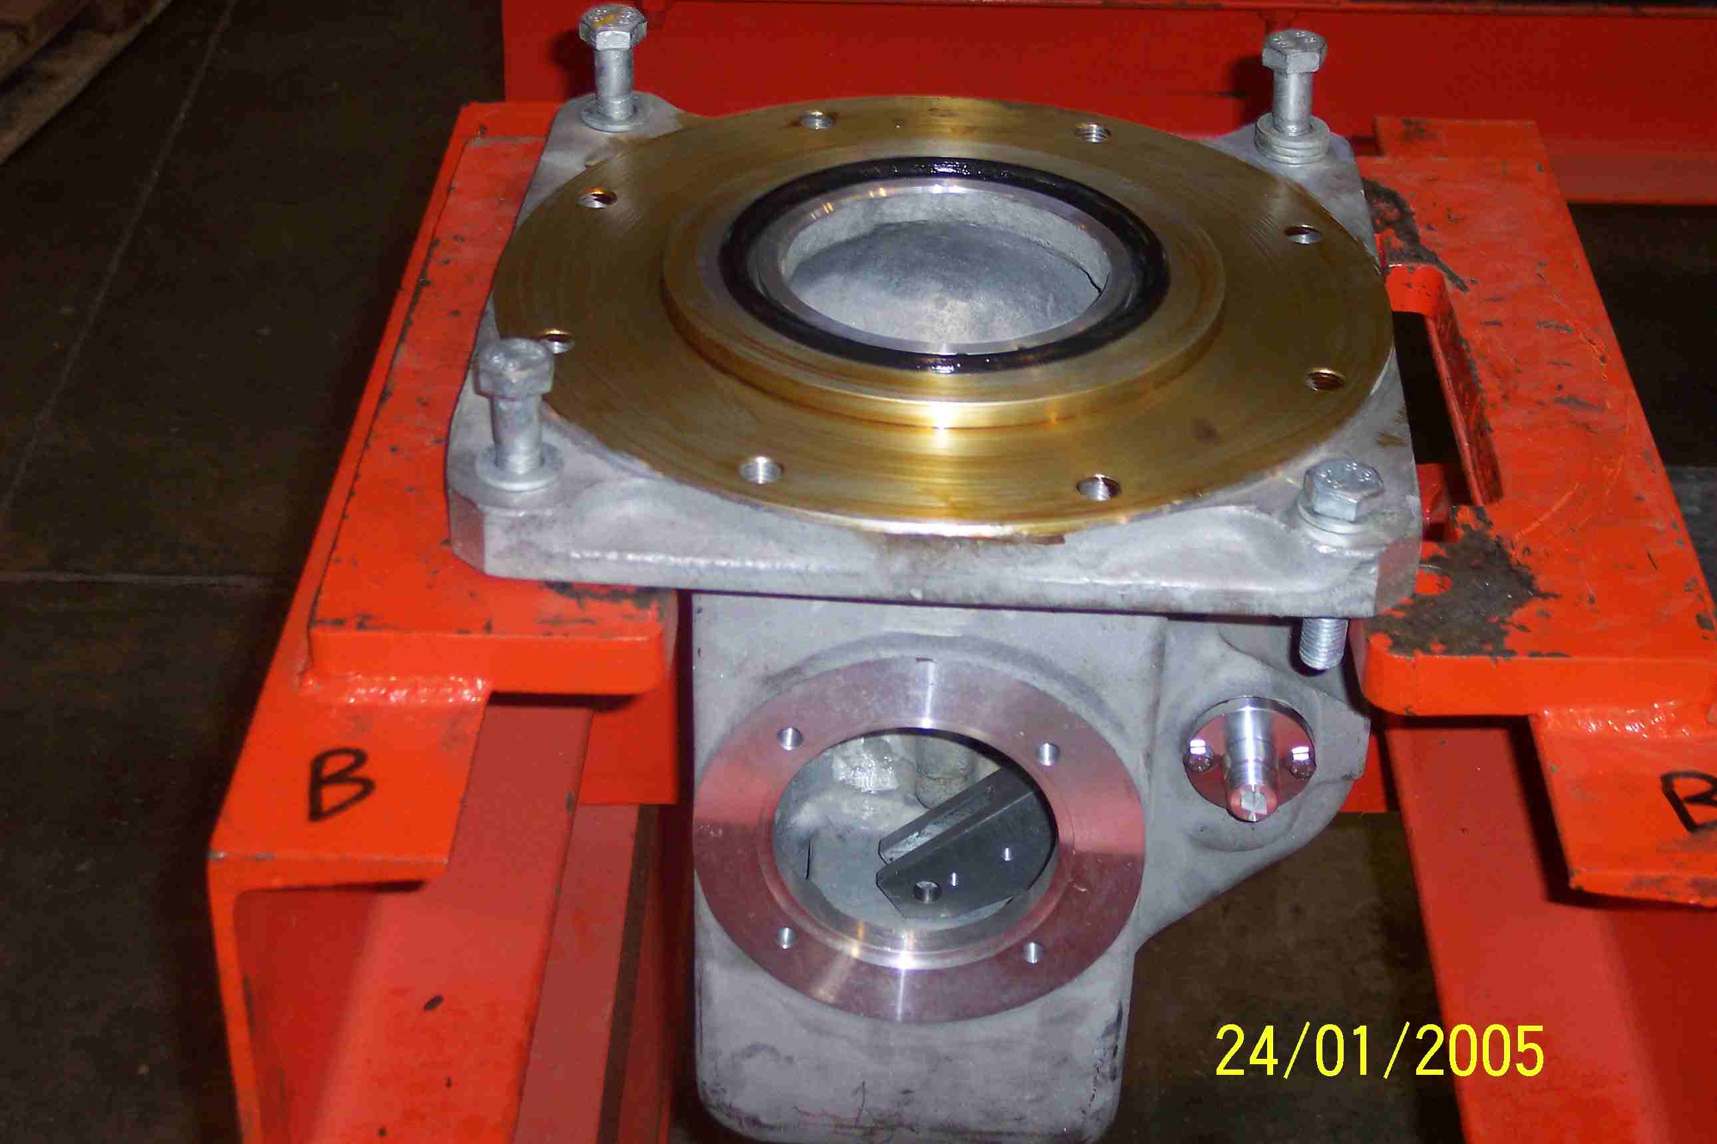
SIEMENS
HVCB SPARES
Gear Box Housing
245KV CB
S4804877005

